Slide 1
The Multiple Linear Regression Model
Part 1
BUAN/MECO 6312
Dr. Moran Blueshtein
University of Texas - Dallas

Slide 2
Introduction
The Econometric Model
Multiple Linear Regression Model
In most economic models there are two or more explanatory variables.
In a general multiple regression model, a dependent variable y is related to a number of explanatory variables x₂, x₃, …, x_{K} through a linear equation that can be written as

Slide 3
Introduction
The Econometric Model
A single parameter, call it β_{k}, measures the effect of a change in the variable x_{k} on the expected value of y, where all other variables are held constant.

Slide 4
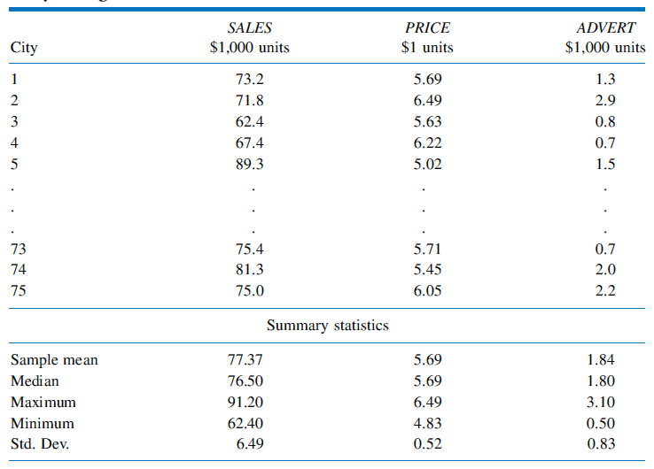
Introduction
Observations on Monthly Sales, Price, and Advertising in Big
Andy’s Bean Burger
The Econometric Model

Slide 5
Introduction
The Econometric Model
The econometric model is:

Slide 6
Introduction
The Econometric Model
β₂ is the change in monthly sales SALES ($1000) when the price index PRICE is increased by one unit ($1), and advertising expenditure ADVERT is held constant

Slide 7
Introduction
The Econometric Model
Similarly, β₃ is the change in monthly sales SALES ($1000) when the advertising expenditure is increased by one unit ($1000), and the price index PRICE is held constant

Slide 8
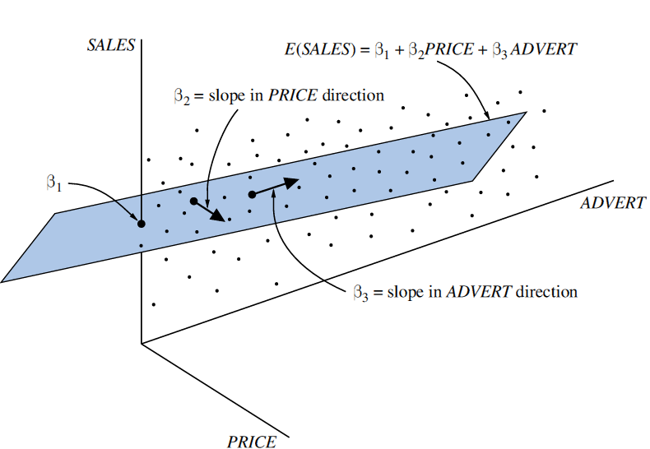
Introduction
The multiple linear regression plane
The Econometric Model

Slide 9
Introduction
The Assumptions of the Model
We make the same assumptions we made before:
E(e) = 0
var(e) = σ²
cov(e_{i},e_{j}) = 0
e ~ N(0, σ²)

Slide 10
Introduction
The Assumptions of the Model
We make an assumption about the explanatory variables:
(New!) Any one of the explanatory variables is not an exact linear function of the others
If this assumption is violated – a condition called exact collinearity - the least squares procedure fails

Slide 11
Estimating the Parameters of the Multiple Linear Regression Model

Slide 12
Introduction
We will analyze a model with 2 explanatory variables:
This model is simpler than the full model, yet all the results we present carry over to the general case with only minor modifications.

Slide 13
Estimating the Parameters of the Multiple Linear Regression Model
Least Squares Estimation Procedure
Mathematically we minimize S(β₁, β₂, β₃), to get the least squares estimators for b₁, b₂, and b₃

Slide 14
Estimating the Parameters of the Multiple Linear Regression Model
Least Squares Estimation Procedure
Least Squares estimators are:
Where:

